Slide 1
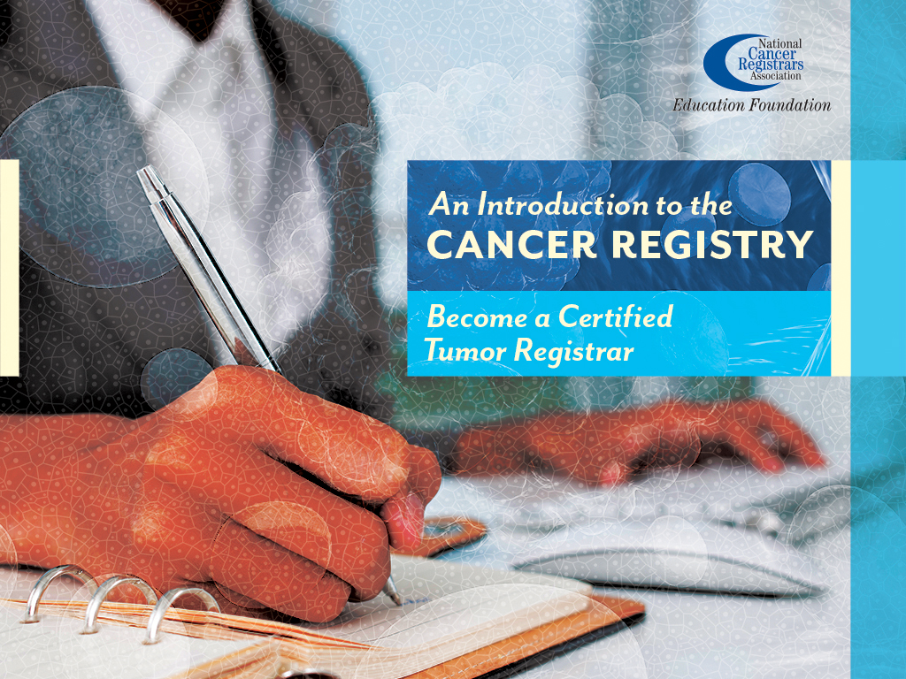
Notes:
This presentation, “Become a Certified Tumor Registrar,” is sponsored by the National Cancer Registrars Association Education Foundation.

Slide 2

Objective:
Explain eligibility requirements to sit for the Certified Tumor Registrar (CTR) examination
Discuss career opportunities for cancer registrars
Notes:
In this presentation, we will explain the eligibility requirements to sit for the Certified Tumor Registrar (CTR) exam and discuss some of the career opportunities in the cancer registry field.

Slide 3
Requirements
Certification examination
  Formal education
  Experience
Notes:
Anyone who is interested in becoming a cancer registrar must meet a few requirements.
Potential cancer registrars must pass a certification exam, called the CTR (or “Certified Tumor Registrar”) exam. And to be eligible to take the CTR exam, candidates must meet educational and experience requirements.

Slide 4
Eligibility Route A – Path 1
Associate’s Degree in Cancer Registry Management (CRM) or Cancer Information Management (CIM) from an NCRA-accredited Program
160-hour practicum in a Certified Tumor Registrar-staffed cancer registry
Notes:
The National Cancer Registrars Association Council on Certification has defined three routes for achieving this goal.
Route A – Path 1: The candidate must successfully complete an Associate's Degree in Cancer Registry Management (CRM) or Cancer Information Management (CIM) from an NCRA-accredited Program and complete a 160-hour clinical practicum in a CTR-staffed cancer registry.

Slide 5
Eligibility Route A – Path 2
Minimum education of an Associate's Degree in any field or the equivalent (60 college-level credits)
Certificate in CRM or CIM from an NCRA-accredited Program
160-hour practicum in a Certified Tumor Registrar-staffed cancer registry
Notes:
Route A – Path 2: The candidate must have an associate’s degree in any field or the equivalent, which is 60 college-level credits.
The candidate must also earn a certificate in Cancer Registry Management or Cancer Information Management and complete a 160-hour clinical practicum in a Certified Tumor Registrar-staffed cancer registry.

Slide 6
Eligibility Route B
Minimum education of an Associate's Degree in any field or the equivalent (60 college-level credits)
Two semesters of Human Anatomy & Human Physiology
1,950 hours (equal to one year full-time) in the cancer registry profession
Notes:
For Route B: The candidate must have a minimum of an associate’s degree in any field or the equivalent. The candidate must also have two semesters of Human Anatomy and Human Physiology and 1,950 hours experience in the cancer registry field.
The 1,950 hours are equivalent to one year of full-time employment.

Slide 7
NCRA-Accredited Programs
http://www.ncra-usa.org/Education/Accredited-Education-Programs/Associate-and-Certificate-Programs
Notes:
Click on this link to view the most updated list of NCRA-accredited formal education programs.

Slide 8
CTR Examination
Offered three time per year
  Spring, Summer and Fall
  Three week window
Examination
  Closed-book (2 hours)
  Open-book (2 hours)
Multiple-choice
Notes:
The CTR exam is offered during a 3-week period in the spring, summer and fall. The candidate makes an appointment at the testing center to take the exam during the three week period. There are two parts to the exam: a closed-book portion, which has 120 questions and an open-book portion, which has 60 questions. The candidate is give 2 hours to complete each portion of the exam, so the exam takes up to four hours. For the open-book portion of the exam, the candidate uses several cancer registry coding manuals to answer questions. All questions are in a multiple-choice format.

Slide 9
Opportunities for Cancer Registrars
Job opportunities
  Hospitals and clinics
  State central registries
  Surveillance, Epidemiology and End Results (SEER)
  National Program of Cancer Registries (NPCR)
  Commission on Cancer (CoC)
  Software vendors
  Consulting companies
Notes:
You may be wondering what opportunities are out there for a cancer registrar. Cancer registrars can find employment
in hospitals, large clinics, and state central registries
at standard-setting organizations such as Surveillance, Epidemiology and End Results, the National Program of Cancer Registries, and the Commission on Cancer.
There are also job opportunities with consulting or contract companies and cancer registry software vendors.

Slide 10
Characteristics of a Certified
Tumor Registrar
Dedicated
Enthusiastic
Self-motivated
Detail-oriented
Medical and scientific knowledge
Working behind the scenes
Notes:
A Certified Tumor Registrar is a dedicated and enthusiastic individual who is self-motivated and detail-oriented. They have medical and scientific knowledge, and enjoy working behind the scenes without face-to-face contact with patients.
The greatest satisfaction for cancer registrars is knowing that their work contributes to the knowledge of cancer, the improvement in patient care, and valuable research on new medical treatments.
If you want to make a difference in the fight against cancer, this may be the career path for you.

Slide 11
Thank You!
CTR Exam Eligibility Flowchart
  www.ctrexam.org/pdfs/eligibility/2012.Flowchart.pdf
NCRA Education Foundation
  www.ncraeducationfoundation.org
NCRA
  www.ncra-usa.org
Notes:
Thank you. This presentation is brought to you by the National Cancer Registrars Association Education Foundation. For more information on the Education Foundation, go to www.ncraeducationfoundation.org. For more information on the cancer registry profession, go to the NCRA website at www.NCRA-usa.org.

