Slide 1
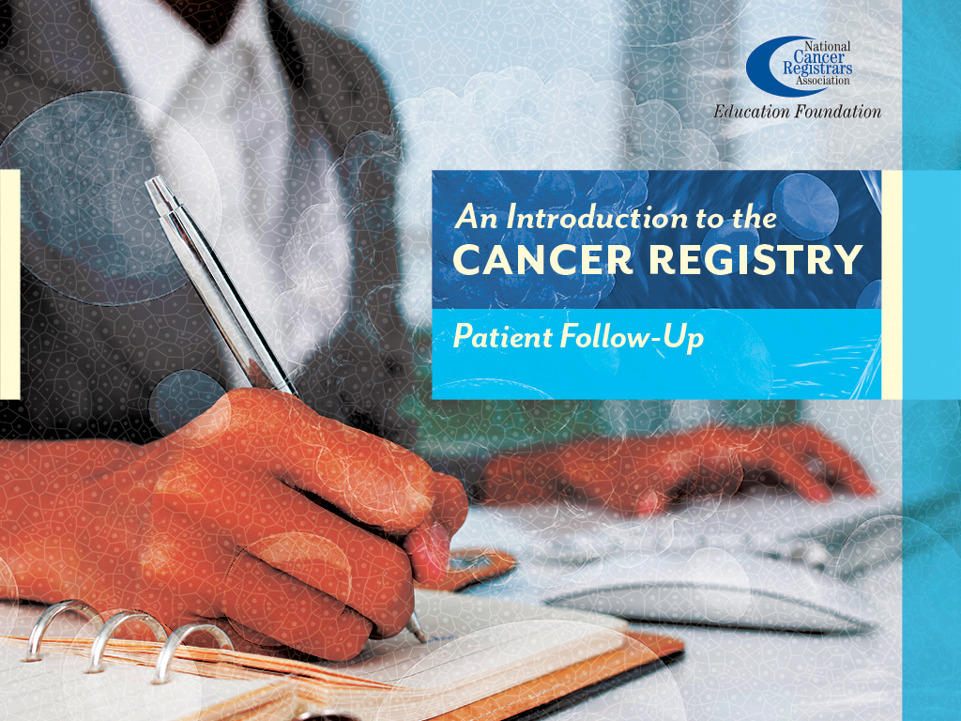
Notes:
This presentation, “Patient Follow Up,” is sponsored by the National Cancer Registrars Association Education Foundation.

Slide 2

Objectives
Define patient follow-up
Identify the goals of follow-up
Review methods used to obtain patient follow-up information
Discuss why lifetime follow-up is important
Notes:
During this presentation we will define what patient follow-up is, identify the goals of follow-up, review the methods used to perform and obtain follow-up, and discuss why lifetime follow-up is an important aspect of the cancer registry.

Slide 3
Follow-Up
“The main purpose of patient follow-up is to determine if the treatment worked.”
E.A. Codman, M.D.
Founding member of the American College of Surgeons
Notes:
Dr. E.A. Codman, one of the founders of the American College of Surgeons stated, ”The main purpose of patient follow-up is to determine if the treatment worked.”

Slide 4
Goals of Patient Follow-Up
Ongoing surveillance
Evaluation of outcomes
Collecting first and subsequent treatment
Reminder to patients and practitioners of continued care
Notes:
Patient follow-up provides ongoing surveillance and a means of evaluating outcomes. Which includes collecting first course of treatment as well as any subsequent treatment due to progression or recurrence of the patient's cancer.
It also serves as a reminder to the patient and practitioner to schedule regular clinical examinations.

Slide 5
Follow-Up Performed Annually
Monthly report generated
Follow-up list compared to various sources
  Hospital admissions
  Outpatient and clinic encounters
  Obituaries
  State death indices
  Other hospital or facility contacts
Notes:
Cancer registrars perform follow-up for each patient on an annual basis.
The cancer registry runs a monthly report listing patients whose abstracts have not been updated in the past 13 months. The registrar then uses multiple sources to find updated information on the patient:
The cancer registrar reviews the patient’s hospital and, if they have access, the clinic medical records to see whether the patient has been seen within the past year.
If there are no new encounters, other sources are reviewed, including obituaries, state death indices, and other facility or registrar contacts.

Slide 6
Follow-Up Process
Review Disease Index for readmissions
Physician letter
Patient letter
Secondary contact letter
Other Cancer Registries
Auto batching
Import from the Disease Index
Notes:
If no new contact date is found after reviewing these sources, the registrar sends a letter to the managing physician to obtain the most recent contact date the physician or clinic had with the patient.
If the physician letter is returned without a more-recent contact date, a patient letter may be sent. The case should be reviewed carefully before a patient letter is sent.
A secondary contact letter may be sent if the patient is a minor or has a legal guardian. Sometimes, a cancer registrar may send a letter to another cancer registry to obtain follow-up information.
Some registries have the capability to import or interface data to update a patient's date of last contact. This is called auto batching. Two application examples would be Accurint People Search or Redsson.
Some cancer registry software have the ability to allow cancer registrars to import data from the Disease Index to update the date of last contact. This saves the cancer registrar time by not having to complete it manually.

Slide 7
Cancer Registry Brochure
Function of a cancer registry
Purpose of request
Use of information
Safeguards to ensure confidentiality
Notes:
When sending a patient letter, most cancer registries include a brochure that explains the function of a cancer registry, why the patient is receiving the letter, and how their information is used by the registry.
The brochure also assures the patient that their information is kept confidential.

Slide 8
Follow-Up Provides
Current cancer status
  Free of cancer
  Recurrent disease
  Additional treatment(s)
  New type of cancer
Notes:
Ongoing patient follow-up provides invaluable surveillance information at the local, regional, and national levels. It is important for outcome statistics to know the patient’s cancer status:
Are they cancer free?
If the cancer has recurred, where did it recur?
Did they have additional treatment?
Have they been diagnosed with a new and different primary?

Slide 9
Follow-Up Rates
Surveillance, Epidemiology and End Results (SEER) Programs
  95% annual follow-up
Commission on Cancer (CoC)
  Standard 5.3 Follow–up in ALL Patients from reference date: 80%
  Standard 5.4 Follow–up on Recent Patients within the past 5 years or reference date whichever is shorter: 90%
  Lost to follow-up
    No contact for >15 months
Notes:
Required follow-up rates are set by various agencies and governing bodies.
SEER Cancer Programs are required to maintain a 95% follow-up rate.
Commission on Cancer-accredited programs must maintain certain follow up rates for two standards:
Standard 5.3 Follow-up on ALL Patients from the facility's reference date must be at least 80%
Standard 5.4 Follow-up on Recent Patients within the past 5 years or the facility's reference date, whichever is shorter, must be at least 90%
When there has been no contact with the patient for more than 15 months, the patient is considered to be “lost to follow-up.” However, this does not mean that the cancer registry never follows up on this patient again. Each year, the patient's medical record should be reviewed to determine if the patient had an encounter at the facility within the last 12 months.

Slide 10
Follow-Up Uses
Surveillance and outcome measures
  Survival rates
Means of assessing regional cancer burden
Assist in allocation of medical resources
Identify changes in regional cancer rates
Notes:
It is important to perform an annual update of information concerning treatment, recurrence, and patient status in order to maintain accurate surveillance and outcome measures, such as survival rates.
Follow up also helps ensure an accurate assessment of the regional cancer burden, which can influence the allocation of medical resources and help to identify changes in the regional cancer rates.

Slide 11
Summary
Follow-up determines if treatment worked
Ongoing patient surveillance and reminder of continued care
Many methods used for follow-up
  Hospital and clinic encounters
  Physician letters
  Patient letters
  Contract services (Redsson, Lexis Nexus, Accurint)
  Internet searches (White Pages)
  Obituaries
  State Reports
Notes:
Follow-up is an organized, sequential method of obtaining information on the current health status of patients to see if their treatment worked.
It serves as a reminder to patients and practitioners about the importance of continued surveillance.
The cancer registry uses many sources, like hospital and clinic encounters, to obtain follow-up information before sending letters to physicians and patients.

Slide 12
Thank You!
NCRA Education Foundation
  www.ncraeducationfoundation.org
NCRA
  www.ncra-usa.org
Notes:
Thank you. This presentation is brought to you by the National Cancer Registrars Association Education Foundation. For more information on the Education Foundation, go to www.ncraeducationfoundation.org. For more information on the cancer registry profession, go to the NCRA website at www.NCRA-usa.org.

