Slide 1
An Introduction to the Cancer Registry
Cancer Registry Coding Activities
Notes:
This presentation, “Cancer Registry Coding Activities,” is sponsored by the National Cancer Registrars Association Education Foundation.

Slide 2
Objectives
Explain the different coding activities available
Demonstrate how to use the manual documents for each coding activity
Notes:
During this presentation, I will explain the different coding activities that are available for you to complete. I will also demonstrate how to use the links and manual documents that are included with the activities.

Slide 3
Coding Activities
Site-Specific Surgery Coding
Chemotherapy and Hormone Therapy Coding
Topography (Site) and Histology Coding
SEER Summary and AJCC TNM Staging
Note: Activities can be completed in any order
Notes:
There are four cancer registry coding activities that are available within this program.
Site-Specific Surgery Coding
Chemotherapy and Hormone Therapy Coding
Topography (Site) and Histology Coding
SEER Summary and AJCC TNM Staging
These coding activities can be completed in any order.

Slide 4
Site-Specific Surgery Coding Activity
Assign the surgery code for each scenario
Standards for Oncology Registry Entry (STORE) documents required:
Colon Surgery Codes
Lung Surgery Codes
Breast Surgery Codes
Notes:
The first coding activity I will discuss is the Site-Specific Surgery Coding Activity.
For this activity, you will assign the surgery code for each scenario. In the cancer registry Standards for Oncology Registry Entry (STORE) Manual, there is a section that lists surgeries that are performed by cancer site. The three cancer sites you will be coding surgeries for are colon, lung and breast. The surgery codes for each site was individually pulled and saved as an individual document and labeled by site, as indicated here.
Let’s take a look at one of these documents.

Slide 5
Breast Surgery Codes
Scenario: Patient had a right simple mastectomy with tissue reconstruction.
Notes:
Here is a portion of the breast surgery codes document.
Lets imagine for the case you are working on, the patient had a right simple mastectomy with tissue reconstruction. You would go to the breast surgery codes and go down the page until you get to the Total (simple) mastectomy code of 40.
If there are more specific codes for that surgery, then these surgeries are listed and indicated by being indented under the less specific code.
For example, for code 40, we would assign this code if we had no idea if the patient had one or both breasts removed. The difference between codes 41 and 42 are, 41 is when the patient has only the breast that is involved with the cancer removed. Code 42 is used if the patient has bilateral mastectomies and the second breast does not have cancer in it. Bilateral mastectomies are sometimes performed for prophylactic reasons to prevent cancer of the other breast in the future.
When patients have mastectomies, there is the possibility that they will also have reconstruction. So, back to our patient who had a right simple mastectomy – which means she only had one breast removed and so far this would be code 41 Total Simple Mastectomy WITHOUT removal of uninvolved contralateral breast. If the patient did not have reconstruction when she had her mastectomy, we would assign code 41. However, our patient did have tissue reconstruction when she had her mastectomy, so we need to continue reading the more specific codes. We would use code 43 if the patient had a mastectomy with reconstruction, but we did not know what type of reconstruction. Since we have the operative report, we know that the patient had tissue reconstruction; therefore, the surgery code for this patient would be code 44. So, let’s review this process. The patient had a total simple mastectomy (click) without the other breast being removed (click) with reconstruction (click) and the type of reconstruction used was tissue. Once again, the surgery code we would assign for this patient would be code 44 (click). When you complete the surgery coding activity, make sure you use the correct site surgery codes for the different scenarios.

Slide 6
Chemotherapy and Hormone Coding Activity
Assign a chemotherapy and/or hormone therapy for each scenario
STORE documents required:
Chemotherapy Codes
Hormone Therapy Codes
SEER*Rx Interactive Antineoplastic Drugs Database
https://seer.cancer.gov/seertools/seerrx/
Notes:
The next coding activity is the chemotherapy and hormone therapy coding activity. Depending on the primary site of a patient’s cancer, they may receive chemotherapy or hormone therapy or a combination of both to treat their cancer.
For this coding activity, it will only ask you for the chemotherapy or hormone code if the patient received that type of therapy. The chemotherapy and hormone therapy coding instructions and code tables are provided for you in two separate documents.
If you viewed the coding module of the Introduction to the Cancer Registry, it talked about a web-based application that cancer registrars use to make sure they code the oncology drugs correctly. This is called the SEER*Rx Interactive Antineoplastic Drugs Database. The link is provided here for your reference; however, the drugs included in your coding activity scenarios are identified as chemotherapy or hormone therapy drugs. So, you will not need to go to SEER Rx to code the drugs in the activity. But if you would like to review the SEER Rx database, the link is provided here.

Slide 7
Chemotherapy and Hormone Codes
Scenario: Patient with breast cancer received chemotherapy drugs Adriamycin and Taxol. After chemotherapy, she started hormone therapy with Arimidex.
Notes:
As you will see when you open these two documents, the chemotherapy and hormone therapy coding is not as specific as the surgery codes are.
On this slide, we have a portion of the chemotherapy coding table and the hormone therapy coding table.
When a patient receives chemotherapy or hormone therapy, the coding is pretty straight forward. Code 00 for both therapies would indicate that the patient did not receive either treatment. Cancer registrars actually do not have to enter code 00 into the database. If no date is entered for a start date, this data field defaults to code 00. Chemotherapy code 01 would be assigned if the patient had chemotherapy, but you did not know the type of drug or number of drugs the patient received. More often than not, we know the regimen the patient received and do not need to use this not otherwise specified code. Code 02 is assigned when the patient receives a single-agent chemotherapy for treatment and code 03 is assigned if multi-agent chemo drugs are used for treatment.
To assign the hormone therapy code, you just need to know if the patient received it or not. If the patient did receive hormone therapy, code 01 would be assigned. The other codes included in both of these tables are codes that specify why a patient may not have received or offered this type of treatment.
Let’s do another scenario together. Our patient had breast cancer and received chemotherapy drugs Adriamycin and Taxol. After chemotherapy, she started hormone therapy with Arimidex.
The patient was given a regimen of two chemo drugs: Adriamycin and Taxol. If you look up those drugs in the SEER Rx application, it would tell you these drugs are categorized as chemotherapy drugs. The chemotherapy code we would assign would be 03 – multi-agent chemotherapy (click). Since this patient also received Arimidex, a hormone drug, we would assign 01 for the hormone therapy data field (click).
For the chemotherapy and hormone therapy code activities included in this module, you will only need to assign a code if the patient was given the therapy. You will not have to record code 00 if the patient did not receive that type of treatment.
Although there are many different types of treatment a patient can receive, such as, radiation therapy and immunotherapy, we have only included chemotherapy and hormone therapy in our activity.

Slide 8
Topography (Site) Codes
Four-character codes
C00.0 to C80.9
Decimal point separates subdivision of the three-character categories
Structure of topography (site) code
Upper-inner quadrant of breast
C | 5 |  | 0 | . | 2
site | subsite
Notes:
Before we discuss Topography site and histology coding activity, lets review the two data fields that cancer registrars use the ICD-O-3 manual for. First is the topography (site) code which has four-characters – More often than not, you will hear the topography code referred to as the site code. So, the words topography and site can be used interchangeably. During this presentation, I use both of them together.
First we will review the topography site code. As its name states, this code identifies the primary site of the patient’s cancer – where the cancer started:
Topography site codes range from C00.0 to C80.9
A decimal point separates subdivision or the subsite of the 3 character categories.
The structure of the topography site code consist of the letter C, a character, then another character, the decimal point then another character
The example given here is C50.2. C50 is the code for breast, the .2 indicates that the tumor was in the upper inner quadrant of the breast which is a subsite of the breast itself. Some primary sites have subsites and some do not. The sites that do not have subsites, are obviously the easier to code.

Slide 9
Histology Codes
Five-digit codes
8000/0 to 9992/3
First four digits is the specific histological term
Fifth digit after the / is the behavior code
Benign: /0
Uncertain whether benign or malignant: /1
Carcinoma in situ: /2
Malignant: /3
Invasive adenocarcinoma = 8140/3
Notes:
The second data field that cancer registrars must use the ICD-O-3 manual for is to assign the histology code. The tumor histology is the type of cancer the patient’s tumor is, such as, small cell carcinoma and squamous cell carcinoma.
The first 4 digits of the histology code designate the tumor cell type of the patient’s cancer.
The 5th digit after the slash is the behavior code for that histology – is the histology benign (behavior code 0), uncertain if benign or malignant (behavior code 1), in situ (behavior code 2) or malignant (behavior code 3) which indicates the tumor is invasive and can metastasize.
An example would be invasive adenocarcinoma code 81403. The 8140 designates that the cancer histology type is an adenocarcinoma and the /3 indicates the tumor is malignant and an invasive type of cancer.

Slide 10
Topography (Site) and Histology Coding Activity
Assign a code for:
Topography code (primary cancer site)
Histology code (type of cancer)
Document or link required
ICD-O-3 Manual http://apps.who.int/iris/bitstream/handle/10665/96612/9789241548496_eng.pdf?sequence=1
ICD-O-3 Online http://codes.iarc.fr/usingicdo.php
Notes:
For the topography site and histology coding activity, you will assign the topography site code (once again, where the tumor started) and the histology code (the type of cancer the patient has).
To complete this activity you can either use the downloaded ICD-O-3 manual or use the ICD-O-3 Online look up. If you instructor has not downloaded the ICD-O-3 manual for you, the link is provided here.

Slide 11
Using ICD-O-3
Manual
Go to Alphabetic Index - page 95
Site and histology codes are listed together
Scroll to find the term(s) you are looking for
Site code example: C71.1 (brain, frontal lobe)
Histology code example: 9440/3 (glioblastoma)
Online
Type in site or histology to search for the code
Notes:
If you use the pdf ICD-O-3 manual to complete this activity, go to page 95 where the alphabetic index begins. Within this section, the site and histology codes are listed together alphabetically. All you have to do is scroll down to find the term(s) you are looking for. The site and histology codes are easily distinguished between one another. The site codes begin with C. For example if you look up the primary site frontal lobe of the brain in the manual, the code assigned for this site is C71.1. The histology codes are five numerical digits in length. If you would look up glioblastoma, a brain tumor, the code to assign would be 9440/3.
If you use the ICD-O-3 online look up link, just enter your term or terms into the search text box to review the possible options from your search.

Slide 12
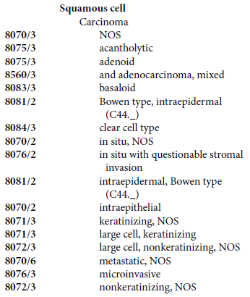
ICD-O-3 Codes
Notes:
Here are two sections from the ICD-O-3 manual. On the left side, we have the eligible site codes for a primary site of the pancreas. As I stated earlier, some sites have what we call subsites, a particular portion of that organ. As you can see with the pancreas, there are multiple subsites. If we did not know what part of the pancreas the tumor involved, then we would have to assign the NOS code, the not otherwise specified code, C25.9 (click). If the patient’s tumor was in the tail of the pancreas, we would assign site code C25.2 (click).
On the right side of the slide, is a partial list of different types of squamous cell carcinomas. The most common squamous cell carcinoma is, just that, squamous cell carcinoma. In that scenario, we would assign the not otherwise specified code of 8070/3 (click). If the patient had a keratinizing squamous cell carcinoma, we would go down the list until we get to that term, which is 8071/3 (click).
This is how cancer registrars look up the topography site and histology codes using the ICD-O-3 manual.

Slide 13
SEER Summary & AJCC Staging Activity
Assign codes for:
SEER Summary Stage
AJCC Cancer Stage
SEER Summary and AJCC documents required
Colon
Lung
Breast
Notes:
The last coding activity that is provided is the staging activity. For this activity, you will assign the SEER Summary Stage and the AJCC Cancer TNM Stage for each scenario.
There are six documents required for this activity. SEER and AJCC have a staging document for each cancer site. For this activity, you will be staging several cases for colon, lung and breast. So, you will have a SEER staging chapter for the colon and an AJCC staging form for the colon. In total, you will use six documents to assign a SEER Stage and AJCC Stage for all three sites. Each staging system is a different manual. We have only included the documents you will need to complete these three cancer sites. We have also included a document titled, SEER Summary Stage – Guidelines. This explains each SEER Stage category in detail. This document is not required to assign the SEER Stage, but it does explain the SEER staging system in more detail than this presentation.
Remember, the purpose of staging is to help the physician assess the extent of the cancer and to determine the most appropriate treatment for the patient. Once the staging work up has been completed, the prognosis of the cancer can be estimated for that individual patient. Staging also assists in the continuing research on cancer and provides a means of comparing local, regional and national data.

Slide 14
SEER Summary Categories
Code | Definition
0 | In situ
1 | Localized only
2 | Regional by direct extension only
3 | Regional lymph nodes only
4 | Regional by BOTH direct extension AND lymph node involvement
7 | Distant site(s)/nodes(s) involved
8 | Benign/borderline
9 | Unknown if extension or metastasis (unstaged, unknown, or unspecified)
For an illustration of these categories, view presentation: An Introduction to the Cancer Registry – Cancer Staging
Notes:
First we will review SEER Summary Stage. SEER Summary Stage is the most basic way of categorizing how far a cancer has spread from its point of origin, the organ or tissue in which it started.
The SEER Summary Stage categories consist of:
In situ – code 0. This type of tumor does not invade the basement membrane of the tissue and there is no stromal invasion.
Localized only – code 1. This is an invasive tumor that is still confined to the site of origin in which it started.
Regional by direct extension only – code 2. This is when the primary tumor mass has grown and invades beyond the site of origin into adjacent tissues and/or organs.
Regional lymph nodes only – code 3. You would use this stage code if the tumor was localized, but there were regional lymph nodes that were positive for cancer.
Regional by both direct extension and lymph node involvement – code 4. This stage code is used when the primary tumor has grown beyond the organ and there are regional lymph nodes positive for cancer.
Distant sites and/or distant lymph nodes involved – code 7. Distant metastases are tumor cells that have broken away from the primary tumor, have travelled to other parts of the body, and have begun to grow at the new location.
Benign and borderline tumors of the brain, CNS and intracranial gland are assigned SEER stage code 8. This code means not applicable.
Unknown or SEER Stage code 9 is used for cancers that are not staged, such as malignant brain tumors, or the stage is unknown or the stage is not specified in the chart.
If you would like an illustration of these categories, please view the presentation titled Cancer Staging of an Introduction to the Cancer Registry modules.

Slide 15
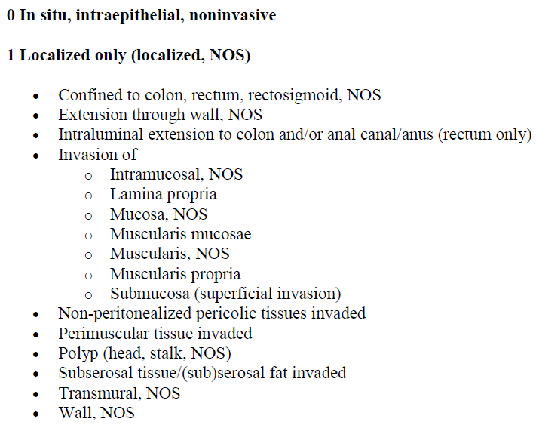
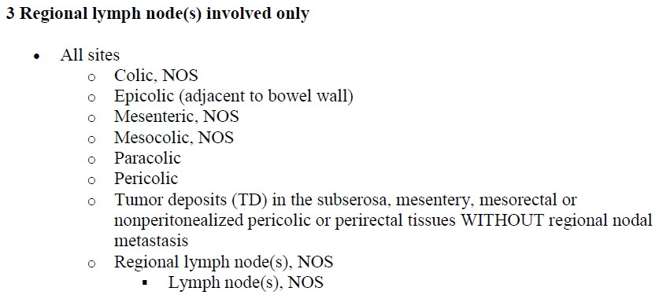
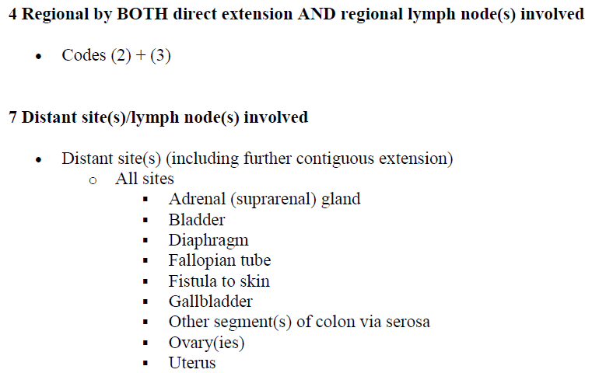
SEER Summary Stage - Colon
Notes:
For your case scenarios in this activity, all the information that is needed to assign the SEER Summary Stage is provided for you.
These print screens are portions of the SEER Summary colon chapter. You can see information is written under each of the SEER Summary categories: SEER 0 – in situ, SEER 1 – localized only, SEER 2 – regional by direct extension only, SEER 3 – regional lymph nodes involved only, SEER 4 – Regional by both direct extension and regional lymph nodes involved, SEER 7 – distant sites/lymph nodes involved. There is also SEER 9 – unknown if extension or metastasis; however, for our scenarios, you will not have to use the unknown SEER Stage.
If a patient has an in situ or non-invasive carcinoma of the colon – SEER Stage category 0 would be assigned, since after the code 0 it states those terms.
Lets say we have a patient with a colon cancer that invaded all the way through the colon wall and into the fat and had 6 lymph nodes positive. We would determine that when a tumor goes through the colon wall and into the fat (click), that is a SEER 2 regional by direct extension (click) – but our patient also had 6 lymph nodes that were positive (click) for cancer, which is a SEER Stage category of 3 (click). So, in this situation when we have both regional by direct extension and regional lymph nodes involved (click), we must assign SEER Stage category 4 (click). When you assign the SEER Stage for your coding activity, just look for the terms and language that is used in the scenario to identify what category is assigned. Like I stated earlier, these are only part of the lists that are included for some of these categories. So, make sure you look at the entire document that you are given.

Slide 16
AJCC Cancer Staging
Categories
Tumor
Nodes
Metastasis
Prognostic Factors
Stage Group
Classifications
Clinical
Pathological
Posttherapy or Post Neoadjuvant Therapy
Recurrence/Retreatment
Autopsy
Notes:
The American Joint Committee on Cancer (AJCC) staging manual allows for more concise staging of the tumor identified by a T, the N is for nodes, and the M indicates if there is distant metastasis or not. Unlike SEER Summary Stage which only had one item to code, for the AJCC stage we have to assign a code for the T, N and M categories, as well as the Stage Group.
Additional factors may play a role in the calculation of the AJCC Stage Group for a disease site. For instance, the breast cancer AJCC stage includes prognostic indicators that are done on the tumor. These include Her2 neu, ER (estrogen receptor) and PR (progesterone receptor). These three prognostic factors and the grade of the tumor are used when we assign the AJCC Prognostic Stage Group.
An AJCC Stage may be defined at several different time points in the care of the cancer patient. These time points are called classifications. The clinical classification uses all information before the initiation of treatment. The pathological classification is based on clinical stage information, operative findings and pathological evaluation of the resected specimen. The posttherapy, or what is most often called post neoadjuvant therapy classification, the stage is determined for those patients that receive systemic and/or radiation therapy before their planned surgery. The recurrence stage classification is assigned at the time of retreatment for a patient that their cancer has recurred or has progressed. The autopsy staging classification is used when cancer is identified at the time of autopsy. For your staging activity, you will only need to assign the pathological stage.

Slide 17
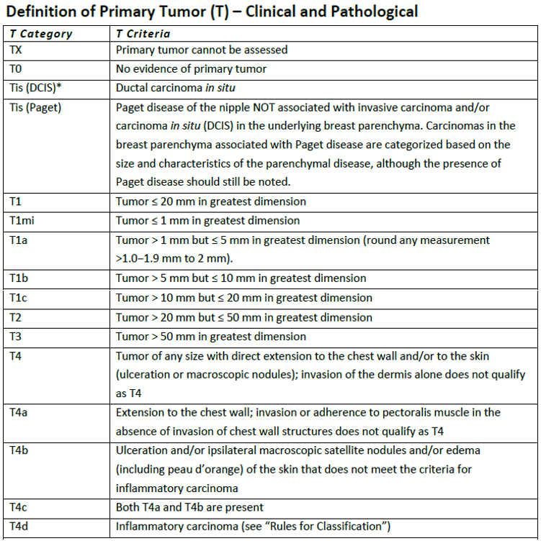
Breast T Category
Notes:
As stated earlier, your coding activities will consist of staging colon, lung and breast cases. Since breast uses prognostic factors to assign the Stage Group, these cases can be more difficult to assign the stage group. Lets review the breast cancer staging form, which more lengthy than the colon and lung forms. We have only included the pages necessary to complete the pathological stage for less confusion, so please do not pay attention when the form states “this form continues on the next page” and there is no next page.
This table is the criteria for each T category that can be assigned. For almost all cancer sites, the first two T categories are TX and T0. TX is used when the tumor cannot be assessed (or the tumor extension cannot be determined by the tests completed) and T0 is when there is no evidence of a primary tumor of the breast. For the scenarios that you will be staging, you will not have to use either of these categories. The next categories listed are two types of in situ breast cancers that a person can have. DCIS is an in situ or non-invasive cancer of the breast and Paget disease is when a patient has a non-invasive cancer to the nipple only. Then we have T1 – with several subcategories listed below T1, including T1mi, T1a, T1b and T1c. If we know the exact size of the tumor, we would use the more specific subcategories. We only use the T1 if we do not know the exact size of the breast tumor, but know it is less than or equal to 20mm or 2cm. The measurement used for the breast staging form is mm; however, more often than not, the radiologist and pathologist use cm as the measure. So, be careful, if your scenario has the tumor size in cm, then you will have to convert that measurement to mm before assigning your T category. Each T subcategory is assigned for a different range of tumor sizes. And that theme continues with the T2 and T3 categories. T2 is assigned if the tumor is stated as more then 2cm but less than or equal to 5cm in greatest dimension. T3 is assigned for all tumors that are greater then 5cm. Once we get to the T4 category, size of the tumor no longer matters. The T4 subcategories are broken into different types of direct extension of a breast tumor. T4a is assigned when there is tumor extension to the chest wall, which does not include the pectoralis muscle. T4b is assigned when there is ulceration, macroscopic satellite tumors and/or edema – also called peau d’orange – of the skin. T4c is assigned if the tumor invades the chest wall and has ulceration, satellite tumors or edema. This tumor has characteristics of both T4a and T4b categories. T4d category is assigned for inflammatory carcinoma of the breast. A very aggressive type of breast cancer.
To demonstrate assign the T category, lets say we have a patient with a 1.5cm breast cancer, we would assign category T1c since the tumor is greater than 1cm but less than or equal to 2cm.

Slide 18
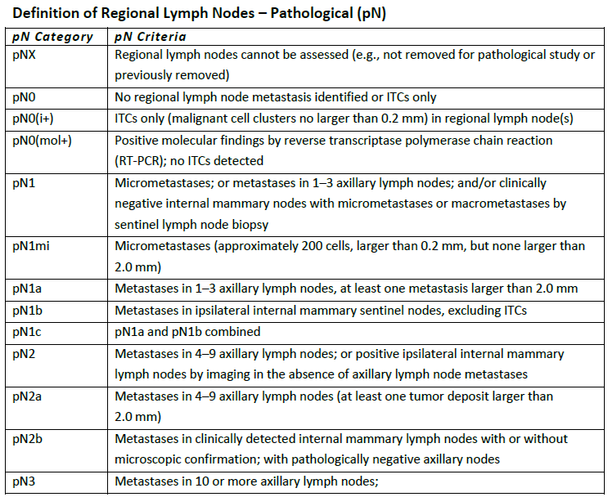
Breast N Category
Notes:
Here is a portion of the Breast N category. Once again, we have the X option, NX, which is assigned if the regional lymph nodes cannot be assessed. For your cases, you will have the lymph nodes information, so you will not have to use this category. N0 category is assigned if all the lymph nodes that were examined by a pathologist were negative. So, if you have negative lymph nodes for your case, it is easy to assign the N category. There are two special studies that a pathologist can perform on the lymph nodes that are resected by a surgeon. If a lymph node or nodes are positive by one of these special studies only, then N0i+ or N0mol+ would be assigned depending on which study identified the positive tumor cells. Basically, this is saying that there are very tiny cancer cells in the lymph nodes that only these special stains can identify. When the lymph nodes are positive for cancer without using these special stains, there are multiple N subcategories we can assign. Let’s review the subcategories for N1. N1mi is assigned when there is micrometastases that are larger than 0.2mm, but none are larger than 2mm. So, size of the metastatic tumor in the lymph node does matter if it is greater than 0.2mm and less than or equal to 2mm.
If the tumor cells in the lymph nodes are larger than 2mm, then we assign the N subcategory by the number and type of lymph nodes that are positive. N1a is when there are 1 to 3 axillary lymph nodes that are positive. N1b is when the internal mammary nodes are positive. N1c is assigned if the patient has 1 to 3 axillary nodes positive and internal mammary nodes positive. N2a category is when there are 4 to 9 axillary nodes that are positive for cancer. N2b is when the physician knows that the internal mammary lymph nodes are positive by imaging, but the axillary lymph nodes that were surgically removed were negative. The subcategories for N3 continue onto the next page of the staging form.
Don’t worry, your case scenarios only deal with axillary lymph nodes, which are the most common lymph nodes that are removed by the surgeon. This won’t be as difficult as you think it will be.

Slide 19
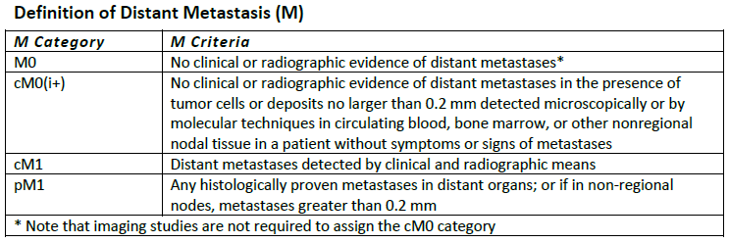
Breast M Category
Notes:
This is the M category table for breast. The M category tables are much smaller than the T and N category tables. As stated earlier, the M category designates whether the tumor has spread to distant sites or distant lymph nodes.
M0 is assigned for cases that the patient has no evidence of distant metastases. As noted at the bottom of the table, imaging studies are not required in order to assign M0. So, if the physician does not state that the patient has distant metastases, we can assign M0. M0i+ is when imaging studies are negative, but there are tumor cells or deposits that are no larger than 0.2mm detected by the pathologist or by molecular studies the pathology may do on the patient’s blood, bone marrow or other nonregional nodal tissue. At this time, this test is not the standard of care when staging a breast cancer, so none of your scenarios will have this situation. The category cM1 is assigned if distant metastases was detected clinically or by imaging studies only. The category pM1 is assigned if there is metastatic disease proven by pathological examination of that metastatic tissue. If a patient has M1 disease, they are then determined to be Stage Group 4. The most advanced stage of cancer a patient can have.

Slide 20
Breast Prognostic Factors
Grade
HER2 – Human epidermal growth factor receptor 2
ER - Estrogen receptors
PR - Progesterone receptors
Notes:
There are four prognostic factors that are required for a breast cancer to be AJCC Staged. The first prognostic factor is grade. As discussed in the Coding presentation, tumor grade is a measure of the aggressiveness of the cancer. Grade can be defined in a number of ways. The most common way to define grade is an assessment of how closely the tumor cells resemble the normal cells of the organ of origin. A few examples would include: well differentiated tumor cells closely resemble the normal cells. Poorly differentiated and undifferentiated tumor cells are disorganized and abnormal looking; poorly differentiated bears little resemblance and undifferentiated has no resemblance to the normal cells from which they originated. Grade is such an important prognostic indicator for breast cancer, that it is used to assign the breast AJCC stage group. If the grade of the tumor is not stated in the pathology report, then the cancer registrar would have to assign the patient’s breast cancer stage as unknown.
The other prognostic factors that are used to assign the breast stage group are, HER2, ER and PR.
The HER2 or human epidermal growth factor receptor 2 gene can play a role in the development of breast cancer. The pathologist will perform a test to determine if the patient’s breast cancer is HER2 positive or negative. If the patient’s breast cancer is HER2 positive, that means the cancer has extra HER2 genes which tells the breast cells to make too many HER2 receptors. These extra receptors make breast cells grow and divide in an uncontrolled way. So, HER2 positive breast cancers tend to grow faster and are more likely to spread or recur. However, now there are medications that can be given to patients with HER2 positive breast cancer to reduce the risk of spreading and recurring.
The breast tumor is also tested to see if it has certain proteins that are estrogen or progesterone receptors. When the hormones estrogen and progesterone attach to these receptors, they fuel the cancer growth. Cancers are called hormone receptor-positive or hormone receptor-negative based on whether or not they have these receptors. Knowing the hormone receptor status is important in deciding treatment options. The ER and PR status is also taken into consideration when assigning the breast stage group, since it is a prognostic indicator of the patient’s outcome. If HER2, ER and/or PR statuses are not included in the pathology report, the cancer registrar would once again have to assign the stage group as unknown. The only time a breast cancer can be staged without one or more of these prognostic factors is if the patient has distant metastasis or Stage IV cancer.

Slide 21
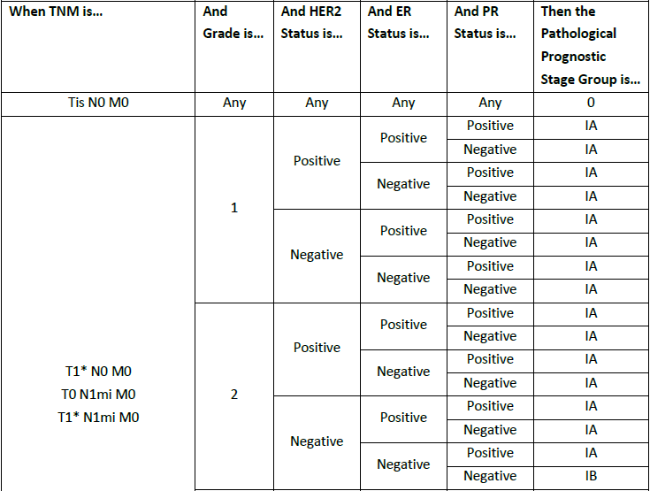
Breast Pathological Prognostic Stage Groups
Notes:
The pathological prognostic stage groups for the breast is 5 pages in length. This is just a very small portion of the first part of the table.
Like I stated earlier, determining the breast stage group is more complicated than the other two sites you will be staging. It looks overwhelming, but it is a table that you read going across the table from left to right, just like anything else you would read.
The first column is titled When TNM is…(click) So, after you have assigned the T, N and M for your case, go to the table and in the first column, find the T, N and M that matches your case. The next column is the tumor grade (click), once you find the TNM that matches your case, then go to the grade of your patient’s tumor, 1, 2, or 3. The next column is the HER 2 status (click), followed by ER (click) and PR status (click). These are what we call prognostic factors of the tumor. These results determine the type of treatment a patient may be offered. The last column is the stage group that would be assigned for your case (click).
Lets do a case together. For this patient, you assigned T1c, N0, M0 for her TN and M. Our first step is to find that in the first column of the table, which is right here (click). The T1 that is listed includes all subcategories of T1, T1mi, T1a, etc. Our patient had a grade two tumor, so we go to the second column and identify grade 2 (click). Then the pathologist stated the tumor was Her2 negative, so we go to the negative of the next column staying even with the grade 2 cell (click). ER and PR status were both negative as well (click x2). We go to the last column and that is our stage group for this patient – Stage Group 1B (click). All the stage groups for AJCC are in Roman numerals; however, when the cancer registrar records the stage group in the abstract we use numbers, 0, 1, 2, 3 or 4, and a capitalized letter when applicable. So, that was a fast and furious lesson in assigning AJCC staging. As you can see, assigning the AJCC stage is a little more detailed and time consuming than the SEER Stage.

Slide 22
Summary
Use the links and manual documents provided to complete the coding activities
Enjoy the experience coding a few data items
Notes:
I hope this presentation helps guide you in completing the coding activities provided to you.
Refer to the slides or instructor guide to identify which documents are required for each activity.
We hope you enjoy this experience of coding a few of the many data items that a cancer registrar must assign codes to for every patient’s abstract.

Slide 23
Thank You!
NCRA Education Foundation
www.ncraeducationfoundation.org
NCRA
www.ncra-usa.org
Notes:
Thank you. This presentation is brought to you by the National Cancer Registrars Association Education Foundation. For more information on the Education Foundation, go to www.ncraeducationfoundation.org. For more information on the cancer registry profession, go to the NCRA website at www.NCRA-usa.org.

