Slide 1
AN INTRODUCTION TO THE CANCER REGISTRY
Data Submission
Notes:
This presentation, “Data Submission,” is sponsored by the National Cancer Registrars Association Education Foundation.

Slide 2
Objectives
Discuss the purpose and benefit of submitting data
Identify the organizations data is submitted to
Review the type of data submitted
Explain the cancer registrar’s role in data submission
Notes:
During this presentation, we will discuss the purpose and benefits of submitting patient and health-related data from a cancer registry.
We will review what type of data is submitted and to which organizations it is submitted to.
We will also explain the cancer registrar’s role in the data submission process.

Slide 3
Purpose and Benefit
Data goes into a larger pool of data
Outcomes
Benchmarking
Decision making
Planning
Notes:
Data collected in cancer registries is part of a larger pool of data utilized for outcomes, benchmarking, decision making, and planning.

Slide 4
State Central Cancer Registries
Designed to:
Monitor cancer trends over time
Determine cancer patterns in various populations
Guide planning and evaluation of cancer control programs
Assist public health professionals
Notes:
By law, all cancer registries must submit data to their state’s central cancer registry.
State central cancer registries monitor cancer trends over time, determine cancer patterns in various populations, and guide planning and evaluation of cancer control programs.
Data collected by state central cancer registries help public health professionals understand and address the nation's cancer burden.

Slide 5
Beyond State Reporting
North American Association of Central Cancer Registries (NAACCR)
Surveillance, Epidemiology, and End Results (SEER)
National Program of Cancer Registries (NPCR)
Notes:
After a state has received the data from the cancer registries, it submits the consolidated data to other organizations. These organizations include:
The North American Association of Central Cancer Registries (NAACCR) which is a collaborative organization for cancer registries, governmental agencies, professional associations, and private groups in North America interested in enhancing the quality and use of cancer registry data. All central cancer registries in the United States and Canada are members.
The Surveillance, Epidemiology, and End Results (SEER) Program provides information on cancer statistics in an effort to reduce the cancer burden among the U.S. population.
Established by Congress through the Cancer Registries Amendment Act, the National Program of Cancer Registries (NPCR) also collects data on cancer occurrence.
Which organization your state reports to depends on your state’s requirements.

Slide 6
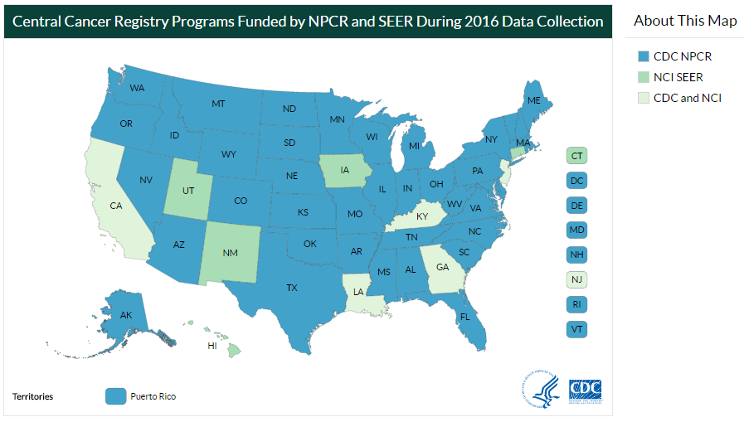
Programs by Funding Status
https://www.cdc.gov/cancer/npcr/public-use/index.htm
Notes:
This map represents the states that are funded and to whom they submit their data.
The states shaded in blue, the District of Columbia and Puerto Rico receive funding through the CDC's National Program of Cancer Registries or NPCR.
The states shaded in the darker green are funded through the National Cancer Institute's Surveillance, Epidemiology, and End Results (SEER) Program.
The five states shaded in the lighter green are funded through CDC's NPCR and the National Cancer Institute's SEER Program.

Slide 7
Commission on Cancer (CoC) Accreditation Program
Establishes standards and guidelines
Collects high-quality data
Develops effective educational interventions
Use data to measure cancer care quality
Submit data to the Rapid Quality Reporting System (RQRS)
Requires annual data submission to the National Cancer Database (NCDB)
Notes:
The Commission on Cancer (CoC) sets standards and guidelines for CoC accredited cancer programs. These standards help ensure the cancer data they receive is accurate and of high quality.
Two objectives for the CoC standards are:
Use collected data to measure cancer care quality
Develop effective educational interventions to improve cancer prevention, early detection, health care delivery, and outcomes in health care settings. It is what we do with the data that makes an impact on quality care.
To retain accreditation, hospitals are required to monitor their data for measures of quality cancer care.
CoC-accredited cancer programs must submit their data to the Rapid Quality Reporting System (RQRS) to ensure evidence-based cancer care is being offered at their facility.
Cancer registrars are also required to submit their data to the National Cancer Database annually. The NCDB is considered a non-population-based specialty registry, as opposed to the state central cancer registry, which is population-based.

Slide 8
Types of Data Submitted
Patient demographics (limited info to NCDB)
Primary tumor site (location of origin)
Tumor morphology (histology)
Cancer stage (extent of tumor spread)
Initial course of therapy (treatment)
Outcomes (vital and cancer status)
Notes:
Data is submitted electronically to the state cancer registry, RQRS and the National Cancer Data Base.
This data includes:
Patient demographics: Limited demographics are sent to NCDB with no patient identifiers submitted. State registries receive all patient demographics since these identifiers are imperative to consolidate cases and coordinate the incidence of cancer with death certificates.
Primary tumor site which is the location of the cancer's origin
Tumor morphology or “histology” - the type of cancer a person has
Cancer stage which categorizes the extent of tumor spread at the time of diagnosis
Initial course of treatment, like surgery, chemotherapy, radiation therapy, immunotherapy and/or hormone therapy
Vital status – for example, whether the patient is alive and if the patient has cancer or has no evidence of cancer

Slide 9
The Cancer Registrar’s Role
Compile data files of abstracts
Run and clear edits for errors
Submit data securely and electronically
Comply with deadlines
Notes:
The cancer registrar’s role is essential for submitting data to their state’s central registry and the National Cancer Database.
They compile the required data and run edits to ensure there are no errors in the abstracts.
Once the data is error free, cancer registrars submit it electronically through a secure website.
The data must be submitted by the deadline date. Each state has its own requirements for timely reporting but it is usually within six months of a patient’s first encounter with the facility.
The NCDB call for data begins in January of each year.

Slide 10
Summary
Data collected used for outcomes, benchmarking, decision making, planning
Standard-setting organizations require different levels of demographics
Cancer registrars collect and submit the data
Notes:
Data collected in the cancer registry is part of a larger pool of data utilized for outcomes, benchmarking, decision making, and planning.
Depending on which standard-setting organization the data is submitted to, more limited demographic information may be sent.
The cancer registrar’s role is essential for accurate and timely data submission to the state central registry and NCDB.

Slide 11
Thank You
NCRA Education Foundation
www.ncraeducationfoundation.org
NCRA
www.ncra-usa.org
Notes:
Thank you. This presentation is brought to you by the National Cancer Registrars Association Education Foundation. For more information on the Education Foundation, go to www.ncraeducationfoundation.org. For more information on the cancer registry profession, go to the NCRA website at www.NCRA-usa.org.

