Slide 1
AN INTRODUCTION TO THE CANCER REGISTRY
Oncology Coding
Notes:
This presentation on oncology coding is sponsored by the National Cancer Registrars Association Education Foundation.

Slide 2
Objectives
Discuss Standards Setters
Discuss Standards for Data Collection
Understand the difference between medical and cancer registry coding
Determine which cancer registry manual/resource to use and when
Notes:
During this presentation, we will discuss Oncology Coding with the following in mind:
Discuss Standards Setters
Discuss Standards for Data Collection
Understand the difference between medical and cancer registry coding
Determine which cancer registry manual/resource to use and when

Slide 3
Standard Setters
Oversee data set requirements:
American College of Surgeons (ACoS) Commission on Cancer (CoC)
Centers for Disease Control and Prevention (CDC) National Program of Cancer Registries (NPCR)
National Cancer Institute (NCI) Surveillance, Epidemiology, and End Results (SEER) Program
North American Association of Central Cancer Registries (NAACCR)
Notes:
It is important that to understand who the standard setters are that oversee data set requirements:
American College of Surgeons (ACoS) Commission on Cancer (CoC) establishes standards for cancer programs.
They evaluate and accredit cancer programs according to those standards. These standards are called Optimal Resources for Cancer Care Standards.
The CoC also publishes the coding manual Standards for Oncology Registry Entry better known as the STORE
Centers for Disease Control and Prevention (CDC) National Program of Cancer Registries (NPCR)’s: Their primary goal is to monitor the burden of disease and plan effective cancer prevention and control programs.
National Cancer Institute (NCI) Surveillance, Epidemiology, and End Results (SEER) Program:
Is the authoritative source of information on cancer incidence and survival in the US
SEER provides information on cancer statistics to support research and to reduce the cancer burden among the US population
North American Association of Central Registries (NAACCR):
Develops and promotes uniform data standards for cancer registration

Slide 4
Standards for Data Collection
Standard data definitions
Collection rules
Uniform data
Allow for data comparison from different sources
Cancer data could not be compared and analyzed without standardized codes
Coding instructions are revised often
Critical registrars use the most current edition/version of manuals and tools
Ensures accurate data collection and reporting
Notes:
The use of standard data definitions and collection rules ensures uniform data, and uniform data allow for the comparison of data from different entities, sources, and systems. Cancer registrars must understand the standards and adhere to processes and procedures to identify the correct codes. Researchers, public-health officials, and health care providers would not be able to compare and analyze cancer data unless it was abstracted using standardized codes.
Coding instructions are revised often, so it is critical that registrars use the most current edition or version of the manuals and application. This once again, ensures accurate data collection and reporting

Slide 5
Medical Coding versus Cancer Registry
Rules and Instructions
Can and do differ
May tell you to do the opposite of each other
Use the appropriate rules for the job you are performing
Use the applicable coding manual/resource
Do not try to memorize cancer registry rules and instructions
“Never Memorize What You Can Look Up in a Book” - Albert Einstein
Notes:
I do want to point out that the language, rules, and instructions can and do differ between medical coding and cancer registry. Frequently, the rules and instructions totally contradict each other, so it is really important that if you are a medical coding and completing cancer registry reporting, that you make sure you take off your medical coding hat and replace it with your cancer registrar hat. The fact that many instructions and rules are not the same, this can be very confusing. But if you use the applicable coding manual for the different data items, you should not have a problem with these differences. You should never try to memorize cancer registry rules and instructions. Always, reference your manuals. Albert Einstein states it perfectly, “never memorize what you can look up in a book.”

Slide 6
NAACCR Data Standards and Data Dictionary
Provide a comprehensive reference to ensure uniform data collection
Facilitate the collection of comparable data among the standard setting agencies
Used by new and existing facility-based and central cancer registries
Ensures that their standard definitions and codes are consistent with those used by facility-based cancer registries, regional and national databases.
Notes:
The NAACCR Data Standards and Data Dictionary is a reference to ensure uniform data collection and is intended for hospital and central cancer registries, cancer registry software vendors, public health researchers and data scientists/analysts.
The NAACCR Data Standards and Data Dictionary:
Provides a comprehensive reference to ensure uniform data collection
Facilitates the collection of comparable data among the standard setting agencies
Is used by new and existing facility-based and central cancer registries to ensure that their standard definitions and codes are consistent with those used by facility-based cancer registries, regional and national databases.

Slide 7
Data Dictionary: Codes and Coding Rules
Each data item has either:
Codes with definitions, or
Reference to the codes and coding instructions.
Source of Standard
Standard-setting agency
Defines the codes, coding instructions and rules for a given tumor
Example: When the source of standard for a data item is SEER the codes section will refer to the SEER Coding Manual for the standard guidelines of the codes and coding instructions.
Notes:
Each data item has either the codes with definitions or a reference to the codes and coding instructions. The Source of Standard is the standard-setting agency that defines the codes, coding instructions and rules for a given tumor. For example, when the source of standard for a data item is SEER the Codes section will refer to the SEER Coding Manual for the standard guidelines of the codes and coding instructions.

Slide 8
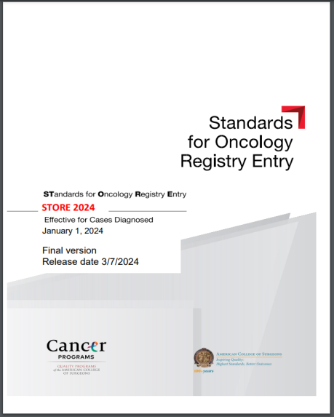
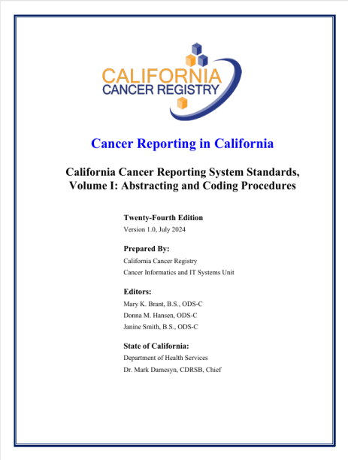
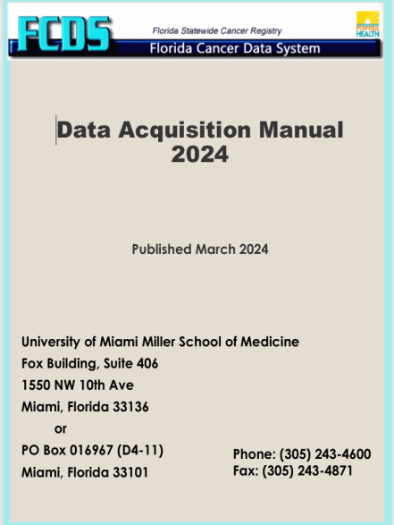
Coding Manuals
CoC-Accredited Facility must follow:
Standards for Oncology Registry Entry (STORE)
State Central Registry Coding Manual
Non-COC-Accredited Facility must follow:
State Central Registry Coding Manual
Notes:
Cancer registries use many coding manuals and databases to determine if a case is reportable and how to code different portions of the abstract.
The coding manuals and resources listed here standardize data collection making sure it is accurate, timely and complete.
CoC-accredited facilities must use the Standards for oncology registry entry (STORE) manual and the state central registry coding manual. Non-CoC-accredited facilities must use their state central registry coding manual. Provided on this slide is a picture of the STORE and two examples of what a state central registry coding manuals may look like.
These manuals are used to assign all the data fields that are not assigned using a different manual. There may be instructions pertaining to the data fields that use other manuals but always remember to use the manual that is the primary resource for that data field.

Slide 9
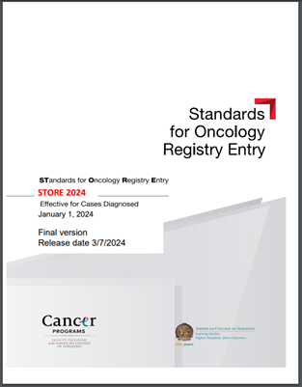
Standards for Oncology Registry Entry (STORE)
Developed by the Commission on Cancer (CoC)
Includes:
Required cases to be reported
Data Dictionary
Description
Rationale
Definition
Coding Instructions
Allowable codes
Notes:
The Standards for Oncology Registry Entry (STORE) manual is developed by the American College of Surgeons Commission on Cancer.
This coding manual incorporates all updates to Commission on Cancer, National Cancer Database Data standards. It includes a data dictionary and is indispensable to all registrars and must be followed by all CoC accredited facilities.
It provides directions on how to accurately complete and code all the data fields of an abstract and clearly instructs abstractors on which malignant and benign tumors are reportable and must be abstracted.
The STORE manual outlines the code description, the rationale, or the reason why the data item is collected, a definition that provides additional background on the data item and its clinical importance, as well as the coding instructions and allowable codes for each data field collected within the abstract.

Slide 10
Solid Tumor Rules
Sections of Manual
General Instructions
Multiple Primary Rules
Determine the number of primaries to abstract
Histology Rules
Assign histology code
If not provided, use:
ICD-O Updates
ICD-O-3.2 Excel document
Notes:
The Solid Tumor Rules manual was developed to promote consistent and standardized coding by cancer registrars. These rules guide the process of determining the number of primary sites (or primaries) a patient has. At times, a patient may have multiple primaries—that is, more than one cancer at the same time or throughout their lifetime. The cancer registrar must complete an abstract for each cancer primary a patient has.
The Solid Tumor Rules also assist the cancer registrar in assigning the correct histology code, especially when the patient's tumor has multiple histologies or a combination of histologies.

Slide 11
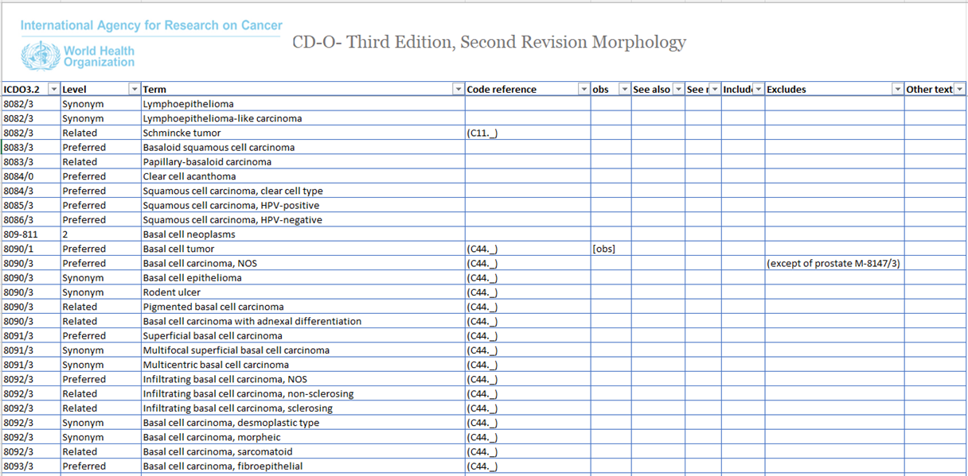
ICD-O-3.2 Excel Table
Notes:
The ICD-O-3.2 Excel Table and Updates is used to assign the histology codes when not provided in the Solid Tumor Rules manual.
The excel table is the standard reference for reportable conditions.
Print screen of the numeric ICD-O-3.2 Table

Slide 12
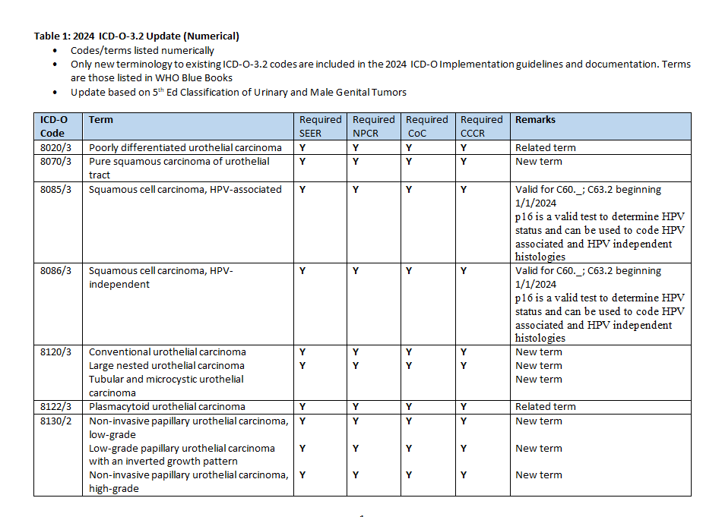
ICD-O-3.2 Update
Notes:
There are multiple updates that registrars must use with ICD-O-3.2. This slide shows some of the ICD-O-3.2, Solid Tumor Rules, and Hematopoietic and Lymphoid Neoplasm Database to assign the histology code and behavior.
The updates is used for malignancy diagnoses being used by pathologists and specialists that may not be in the current ICD-O-3.2 edition.

Slide 13
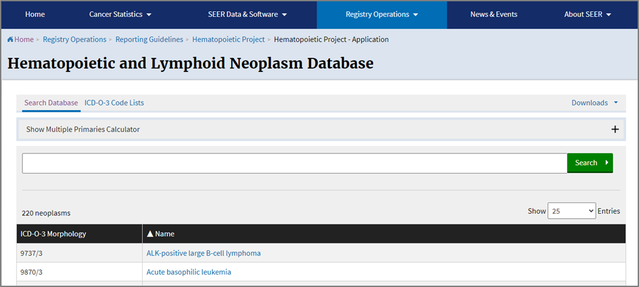
Hematopoietic and Lymphoid Neoplasm Database and Manual
The “Heme” Database and Manual enable reporters to:
Identify and understand hematopoietic and lymph node neoplasms (non-solid tumors)
Correctly and consistently code cases
Notes:
We have the solid tumor rules manual to assist us in abstracting the correct number of cases for a patient as well as assigning the histology code for solid tumors. For non-solid tumors, the hematopoietic and lymphoid neoplasms, such as leukemia, we have this database and manual to assist us in doing the same thing for these tumors. The coding manual provides reportability instructions and rules for determining the number of primaries, the primary site and histology as well as the cell lineage or phenotype. The introduction of the manual has steps in priority order for using the database and manual. It is essential that we follow these steps to ensure that we determine the correct number of primary tumors the patient has as well as the correct histology code.
The heme database is a tool to assist us in screening for reportable cases and determining reportability requirements. The database contains abstracting and coding information for all hematopoietic and lymphoid neoplasms. It tells us what histology code to assign. It also includes excellent information about the diagnostic studies that are usually done to diagnose a specific neoplasms.

Slide 14
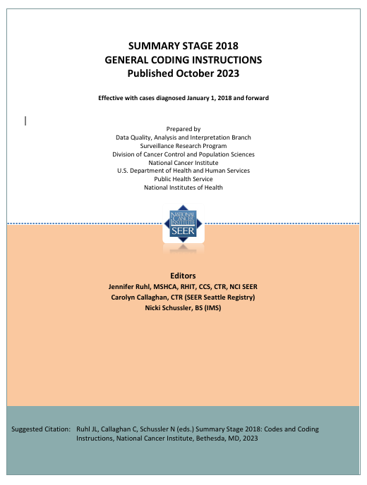
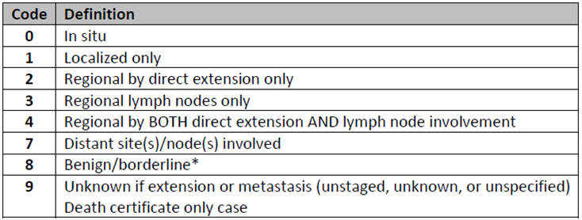
SEER Summary Stage
Basic way of categorizing how far cancer has spread from its point of origin
Applicable for all malignant primary sites
Combination of clinical and pathological
Clinical – Information prior to treatment
Pathological – Information includes surgical resection
Notes:
Summary Stage is the most basic way of categorizing how far a cancer has spread beyond its point of origin or where the cancer began.
Summary Stage applies to every site and/or histology combination, including lymphomas and leukemias. Summary Stage uses all information available in the patient’s medical record. It is a combination of the most precise clinical and pathological documentation of the extent of the cancer. One manual to code one data item. The code structure of summary stage is provided on this slide.
Central Registries report their data by summary stage as the staging categories are broad enough to measure the success of cancer control efforts and other epidemiologic efforts.

Slide 15
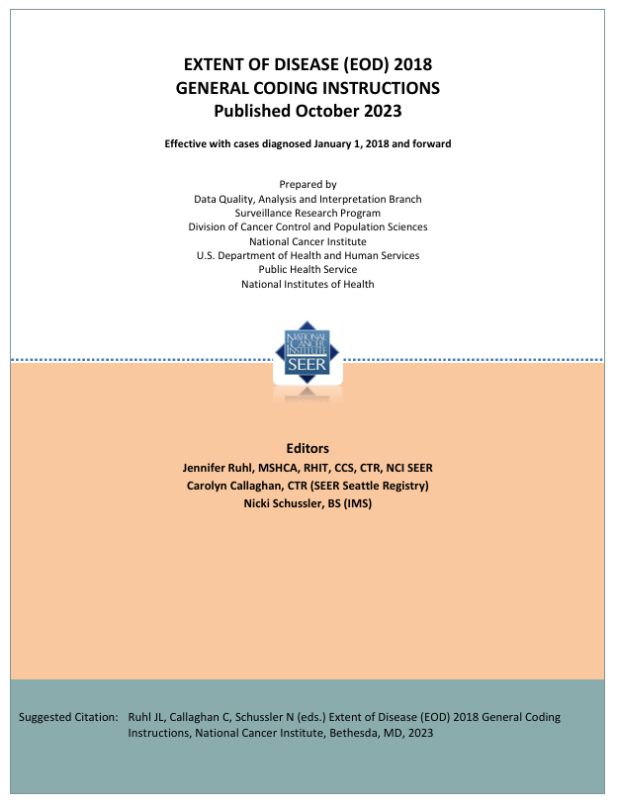
Extent of Disease (EOD)
Required to be collected for SEER registries
EOD Primary Tumor
EOD Regional Nodes
EOD Mets
These three EOD data items drive
EOD TNM T
EOD TNM N
EOD TNM M
EOD TNM derive EOD TNM Stage Group based on the AJCC Staging System
Notes:
SEER registries in the United States are required to collect Extent of Disease (EOD) information (EOD Primary Tumor, EOD Regional Nodes, EOD Mets). These three EOD data items derive EOD TNM T, EOD TNM N and EOD TNM M, along with an EOD TNM Stage Group based on AJCC.

Slide 16
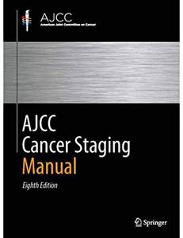
AJCC Cancer Staging System
TNM System for cancers of virtually every anatomic site and histology
Categories
T = Tumor
N = Lymph Nodes (Regional)
M = Distant Metastases
Stage Group
Notes:
Like with summary stage, there is a TNM staging for cancers of virtually every site and histology, except for pediatric cancers, brain tumors, lymphoma, and leukemia. As the WHO blue books get updated, AJCC is updating the 8th edition chapters to 9th edition. Each chapter is published as a separate booklet.
The AJCC TNM system classifies cancers:
by the size and extent of the primary tumor (T)
Involvement of regional lymph nodes (N)
Presence or absence of distant metastases (M)
Supplemented in recent years by evidence-bases prognostic and predictive factors. These prognostic and predictive factors are recorded as SSDIs in the abstract.
This gives us the stage group of the patient’s cancer
Unlike summary stage where there is only one stage documented, the AJCC TNM Stage may be defined at several time points in the care of the cancer patient. To properly stage a patient’s cancer, it is essential to first determine the time point in a patient’s care. These time points (time frames) are termed classifications, and are based on time during the continuum of evaluation and management of the patient’s disease. The T, N, and M categories are assigned for classifications by using the information obtained during that time frame. The staging classifications that cancer registrars record in the patient’s abstract are clinical, pathological, post therapy clinical and post therapy pathological.

Slide 17
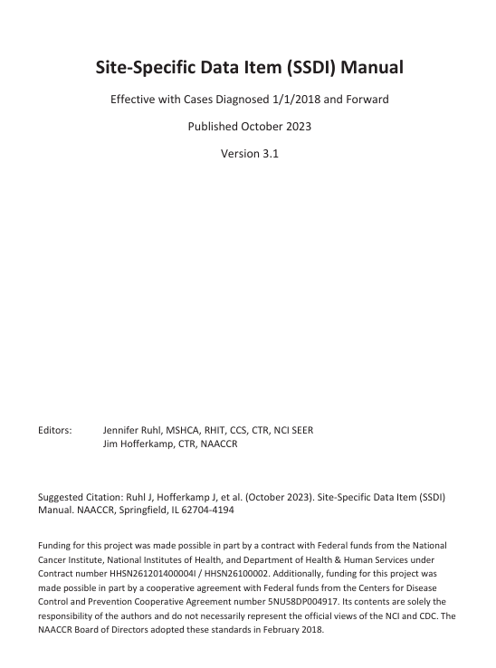
Site-Specific Data Item (SSDI) Manual
Resource for coding instructions for site-specific data items
Data dictionary
Sample SSDIs include:
Colon – CEA Pre-Tx Lab Value
Melanoma – Breslow Thickness
Breast – ER/PR Percentage or Range
Prostate – number of biopsy cores positive/examined
Notes:
The site-specific data item (SSDI) Manual is the primary resource for documentation and coding instructions for site-specific data. Different cancer sites and histologies have different SSDIs. The cancer registry software makes this easy for us. For most sites, once the registrar enters the site code and histology, the software brings up the SSDIs data fields that pertain to that site/histology. Like the STORE Manual, the SSDI Manual is a data dictionary that outlines the code description, the rationale, a definition that provides additional background on the data item and its clinical importance, as well as the coding instructions, format and allowable codes for each site-specific data item for that cancer site.
Examples of site-specific data items that are collected for breast cancer include estrogen receptor status and progesterone receptor status. An SSDI colon cases is the CEA Pre-treatment lab value. Other site-specific data items are listed on the slide.
The number of SSDIs collected depends on the site. Some sites have no SSDIs and others, like breast have a lot of SSDIs.

Slide 18
Grade Coding Instructions and Tables
Resource for coding instructions for assigning tumor grade
Four specific grade data fields/items:
Grade Clinical
Grade Pathological
Grade Post Therapy Clin (yc)
Grade Post Therapy Path (yp)
Clinical and Pathological must have a code assigned even if unknown
Post Therapy Clin and Path are assigned codes if applicable to case
Notes:
The grade coding instructions and tables, also called the Grade Manual, is the primary resource for documentation and coding instructions for assigning tumor grade, which is a measure of the aggressiveness of the tumor.
There are four data items in which this manual is used by the registrar:
Grade clinical – the grade of the tumor prior to the patient having treatment (usually the diagnostic biopsy)
Grade pathological – the grade of the tumor after the patient’s tumor has been resected
A grade code must be assigned for both grade clinical and grade pathological. This means these data items/fields cannot be left blank
Post therapy clinical (yc) grade of the tumor is assigned if the patient has received neoadjuvant therapy and then has a biopsy
Post therapy pathological (yp) grade of the tumor is assigned if the patient has received neoadjuvant therapy and then has the primary tumor resected

Slide 19
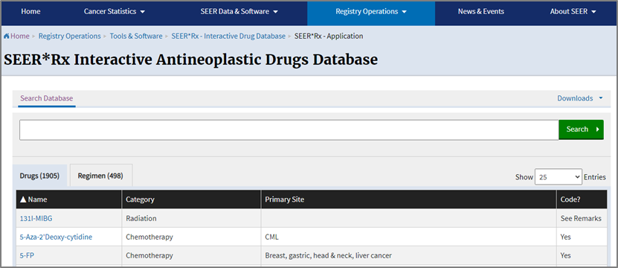
SEER*Rx Interactive Antineoplastic Drugs Database
Web-based Database to Search for Drugs and Regimen
The category of the drug is listed:
Chemotherapy
Immunotherapy (BRM)
Hormone Therapy
Ancillary
Notes:
SEER*Rx interactive drug database was developed as a one-step lookup for coding oncology drug and regimen treatments by category. This database makes our job a lot easier since it tells us exactly how to code something.
Registrars enter a drug name or regimen, and it will tell them if that drug (or drugs) are chemotherapy, immunotherapy, hormone therapy, or an ancillary drug which are not recorded as cancer treatment.

Slide 20
Key Points
Standard Setters set the data item requirements
Medical coding differs from Cancer Registry coding
Cancer registries use many coding manuals and databases to determine if a case is reportable and to code different portions of the abstract.

Slide 21
Thank You
NCRA Education Foundation
www.ncraeducationfoundation.org
NCRA
www.ncra-usa.org
Notes:
Thank you. This presentation is brought to you by the National Cancer Registrars Association Education Foundation. For more information on the Education Foundation, go to www.ncraeducationfoundation.org. For more information on the cancer registry profession, go to the NCRA website at www.NCRA-usa.org.

